Slide 1

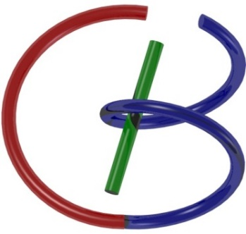
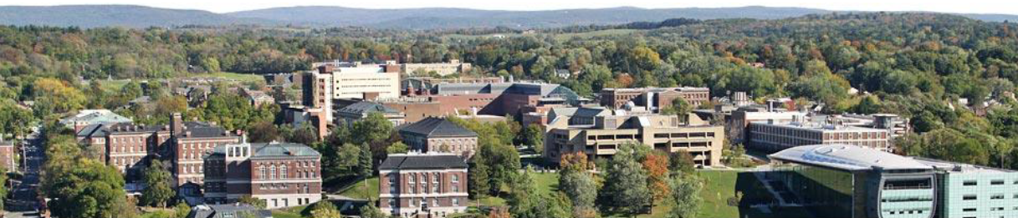
CT Reconstruction – Cone-beam: Approx
Ge Wang
AI-based X-ray Imaging System (AXIS) Lab
Rensselaer Polytechnic Institute, Troy, New York, USA
September 12, 2023

Slide 2
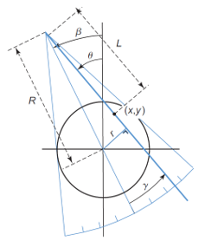
Homework
What is the angular range [0, x] for β so that fan-beam projection data meet the sufficient condition for image reconstruction? In other words, x=?

Slide 3
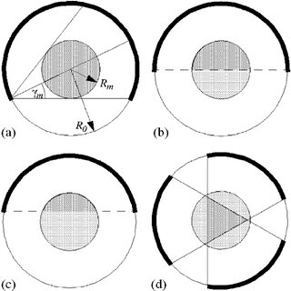
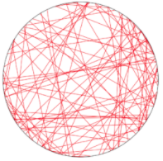
Homework Hint

Slide 4
Outline
Motivation
Fan- to Cone-beam Geometry
Long & Flat Object Problems
Heuristics for Spiral CT
Fan-beam Spiral CT
Cone-beam Spiral CT
Clinical Applications

Slide 5
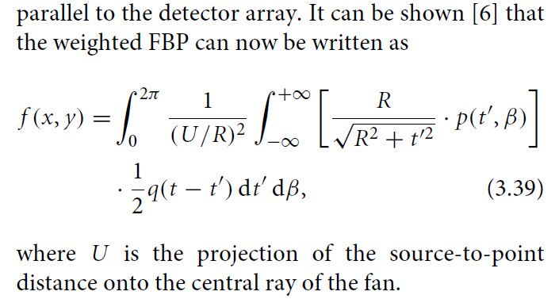
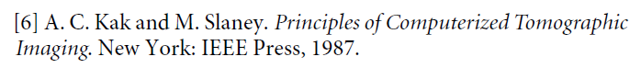
Equi-spatial Fan-beam Formula
Wang, Lin, Cheng: IEEE TIP 2:543-547, 1993

Slide 6
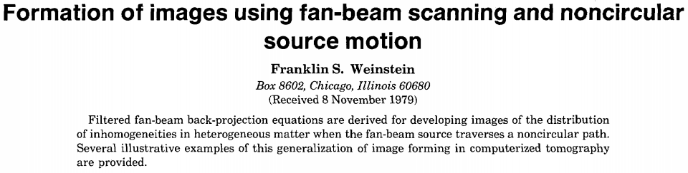
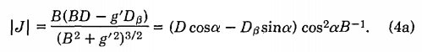
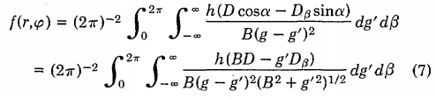
Otherwise, D’(β)=D_{β} in the Formula
If You Have D_{β} in the Formula, the Reconstruction Is Sensitive to Trajectory Noise;
If You Resort Data to the Parallel-beam Format, You Compromise Image Resolution.
https://www.osapublishing.org/josa/abstract.cfm?uri=josa-70-8-931

Slide 7
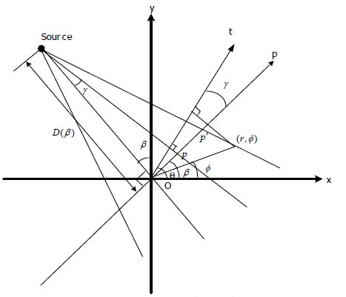
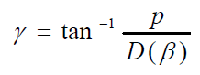
Hint: Where is the Error?

Slide 8
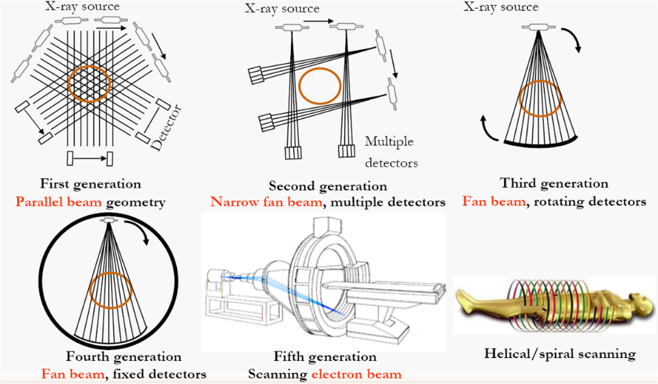
CT Scanning Modes

Slide 9
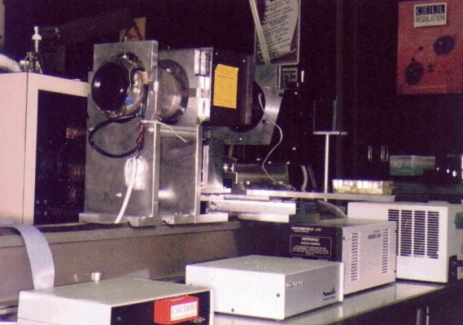
Cone-beam μCT System (1990)
Advanced Microscopic Imaging Lab, SUNY/Buffalo

Slide 10
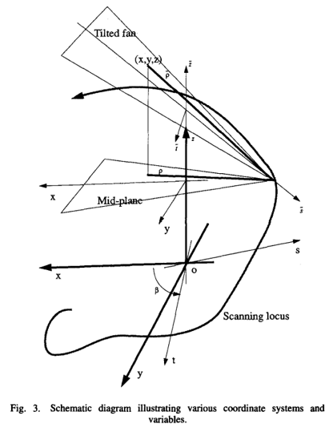
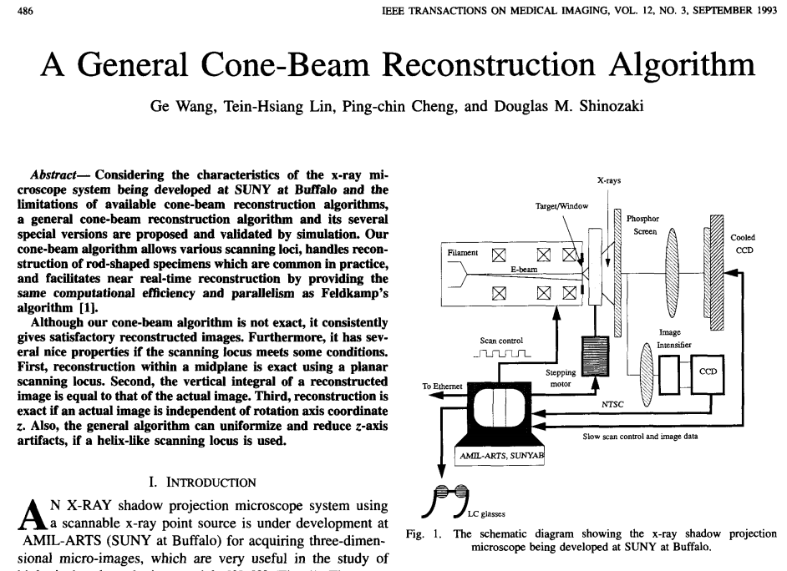
General Cone-beam Scanning
https://ieeexplore.ieee.org/stamp/stamp.jsp?tp=&arnumber=241876

Slide 11
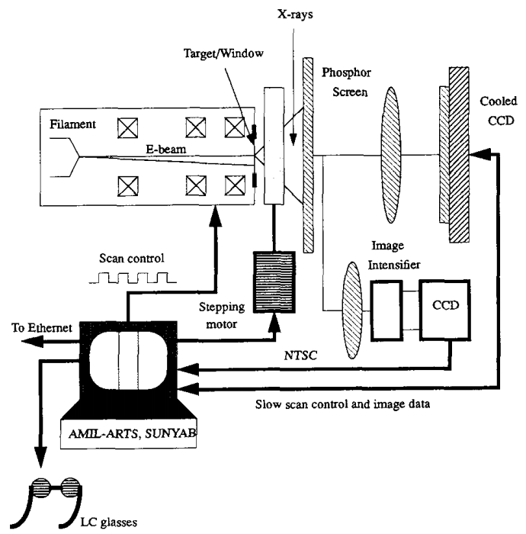
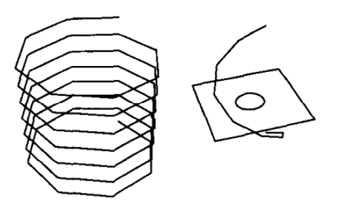
Broken-line Orbit with E-beam Scan

Slide 12
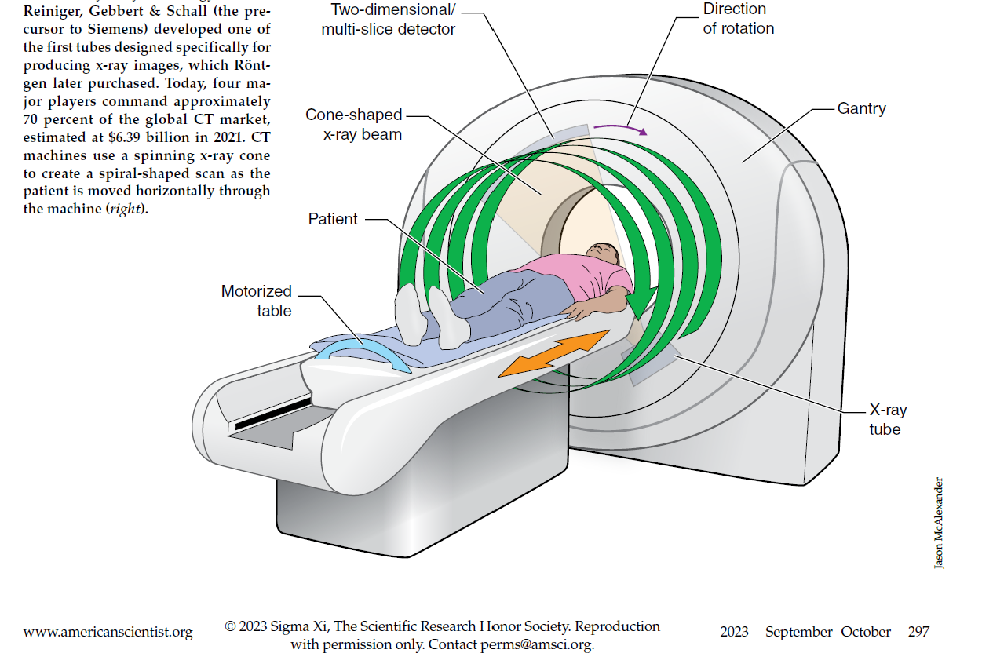
Cone-beam Spiral CT

Slide 13
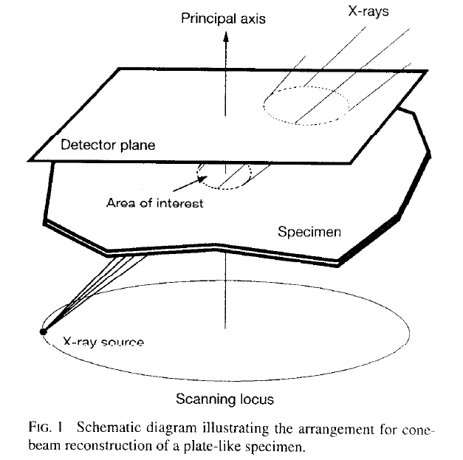
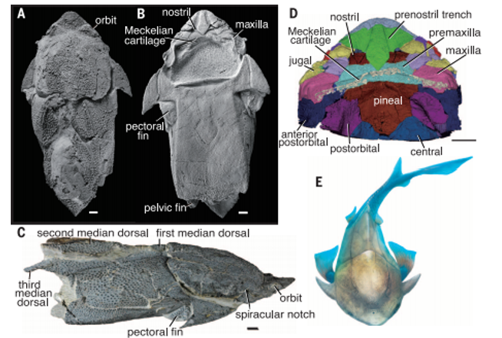
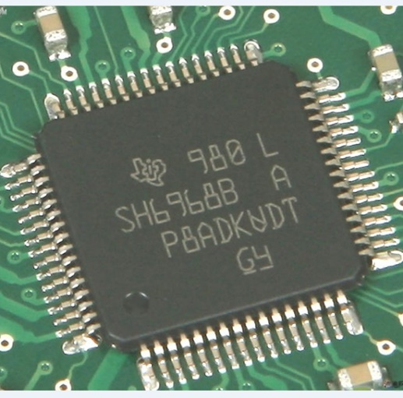

High-tech Flat Object

Slide 14
Outline
Motivation
Fan- to Cone-beam Geometry
Long & Flat Object Problems
Heuristics for Spiral CT
Fan-beam Spiral CT
Cone-beam Spiral CT
Clinical Applications

Slide 15
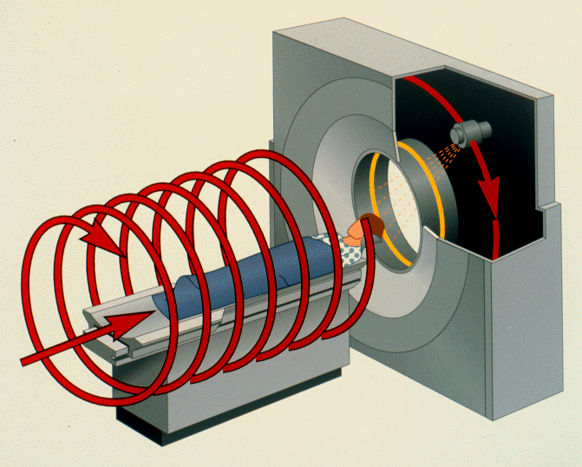
Fan-beam Spiral/Helical CT

Slide 16
Spiral/Helical/Volumetric CT
z
y
Source
x
Detector Array
Helical Locus
Incomplete projection data for any transaxial plane

Slide 17
Linear Interpolation & Extrapolation
y=f(x)
Xi: Interpolation point
Xe: Extrapolation point
x1
xi
x2
xe
x

Slide 18
Full-Scan Interpolation (FI, 360LI)
z
y
x
Ray A

Slide 19
Half-Scan Interpolation (HI, 180LI)
z
y
x
Ray A

Slide 20
Half-Scan Extrapolation
z
z
y
Ray B
x
Ray A

Slide 21
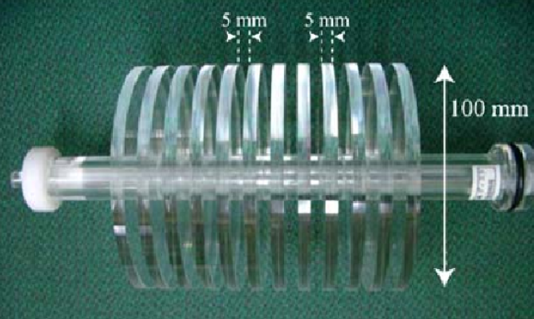
Slice Sensitivity Profile (SSP)

Slide 22
Minus: Wider Slice Sensitivity Profile
CT Number
Incremental CT Slice Thickness
Spiral/Helical CT
mm
Spiral CT increases the SSP as compared to
incremental CT due to continuous table motion

Slide 23
Longitudinal Motion Blurring
Conventional Scanning
Spiral Scanning
(From JA Brink at Yale U)
Through-plane motion artifacts are
suppressed by single-breath-hold spiral scanning but longitudinal motion blurring is introduced

Slide 24
Plus: Denser Retrospective Recon
Retrospective
reconstruction
Direct reconstruction
Scanning loci
Slices
Scanning locus
Slices

Slide 25
Finer Longitudinal Sampling
Retrospective
reconstruction
Direct reconstruction

Slide 26
Longitudinal Bandwidth Comparison
One-tenth
cutoff
Conventional CT
Spiral CT
Mean
square-root
Collimation =
Table feed

Slide 27
Spiral CT: Better Resolution
“For a given X-ray dose,
helical CT allows substantially better
longitudinal resolution than
conventional CT due to
its inherent retrospective
reconstruction capability.”
Wang and Vannier
Medical Physics 21:429-433, 1994

Slide 28
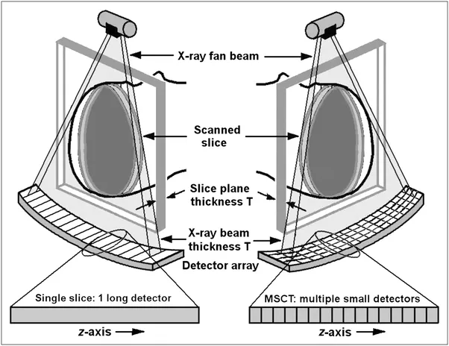
Narrow to Wide Cone-beam Angle

Slide 29
Spiral Cone-beam Geometry
To solve the long object problem, the spiral/helical cone-beam scanning mode and an approximate reconstruction algorithm were first proposed by Wang et al. in 1991
Wang et al.: Scanning cone-beam reconstruction algorithms for x-ray microtomography. Proc. SPIE v. 1556, p. 99-112, July 1991
Object
Source
Detector
Plate
General Locus

Slide 30
Citation Counts
To solve the long-object problem, a first level of improvement with respect to the 2D FBP algorithms was obtained by backprojecting the data in 3D, along the actual measurement rays. The prototype of this approach is the algorithm of Wang et al.
Defrise, Noo, Kudo: A solution to the long-object problem in helical cone-beam tomography. Phys. Med. Biol. 45:623-643, 2000
Many advances in CB reconstruction have been made recently thanks to the quest for an attractive reconstruction method in helical CB tomography.
Pack, Noo, Clackdoyle: Cone-beam reconstruction using the backprojection of locally filtered projections. IEEE Trans. Medical Imaging 24:1-16, 2005
~200M Multi-slice/Cone-beam CT Scans Annually

Slide 31
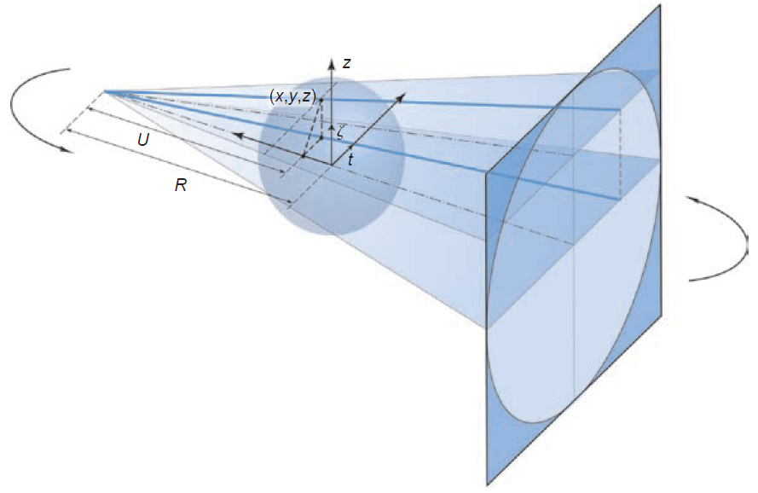
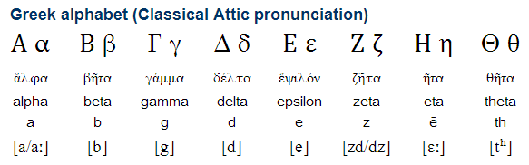
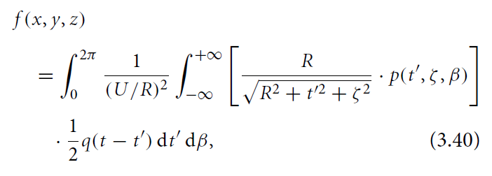
Cone-beam Geometry
The detector plane mapped onto
the t-z plane
(which is convenient, being consistent to the fan-beam case)

Slide 32
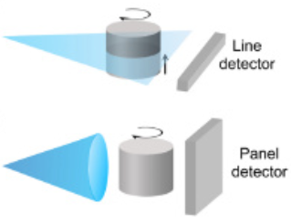
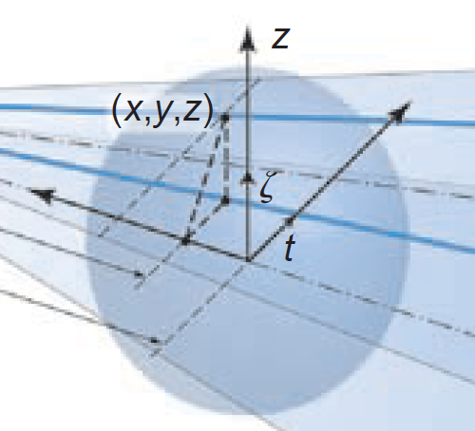
Cone-beam to Fan-beam Data

Slide 33
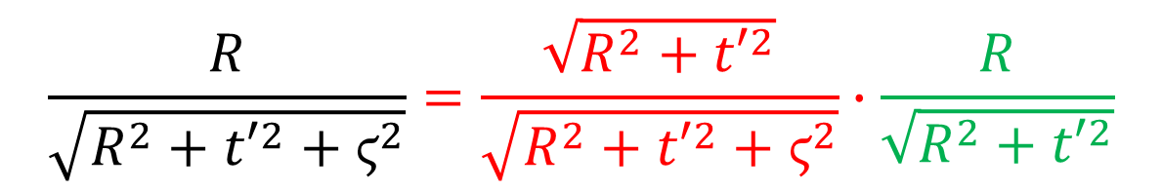
Cone-beam Scanning
General Scanning Trajectory
α
β
$$\frac{R}{\sqrt{R^{2}+{t′}^{2}+ϛ^{2}}}=\frac{\sqrt{R^{2}+{t′}^{2}}}{\sqrt{R^{2}+{t′}^{2}+ϛ^{2}}}∙\frac{R}{\sqrt{R^{2}+{t′}^{2}}}$$

Slide 34
Cone-Beam to Fan-Beam Data
Tilted fan
Virtual in-plane
X-ray source
γ
Object point
Tilting angle
X-ray source

Slide 35
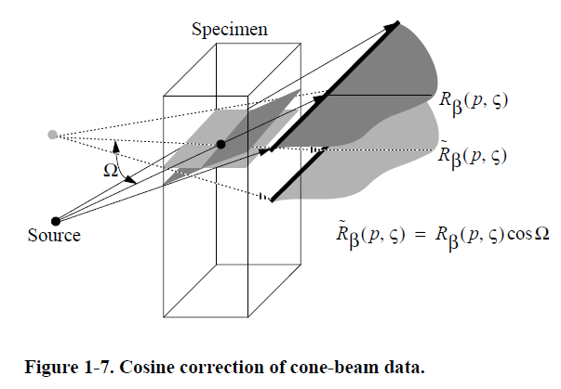
Another View of Cosine Correction
Wang G, Zhao SY, Cheng PC: Exact and approximate cone-beam X-ray microtomography (Chap. 1). Focus on multidimensional microscopy (I) (Editors: Cheng PC, Huang PP, Wu JL, Wang G, Kim HG), World Scientific, Singapore, 233-261, 1999

Slide 36
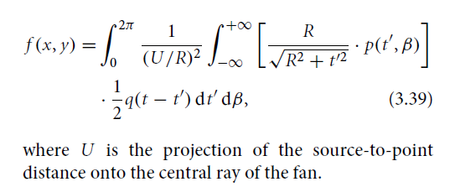
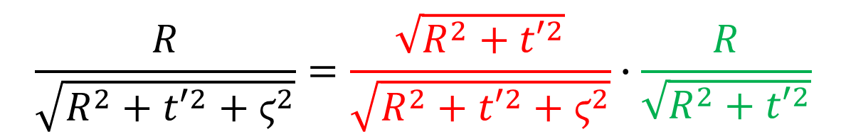
Obliqueness Correction
An X-ray Hits the 2D Detector Plate Obliquely, Determined by Two Angles
Obliqueness Correction in Fan-beam Formula
Obliqueness Correction in Cone-beam Formula
$$\frac{R}{\sqrt{R^{2}+{t′}^{2}+ϛ^{2}}}=\frac{\sqrt{R^{2}+{t′}^{2}}}{\sqrt{R^{2}+{t′}^{2}+ϛ^{2}}}∙\frac{R}{\sqrt{R^{2}+{t′}^{2}}}$$

Slide 37
Outline
Motivation
Fan- to Cone-beam Geometry
Long & Flat Object Problems
Heuristics for Spiral CT
Fan-beam Spiral CT
Cone-beam Spiral CT
Clinical Applications

Slide 38
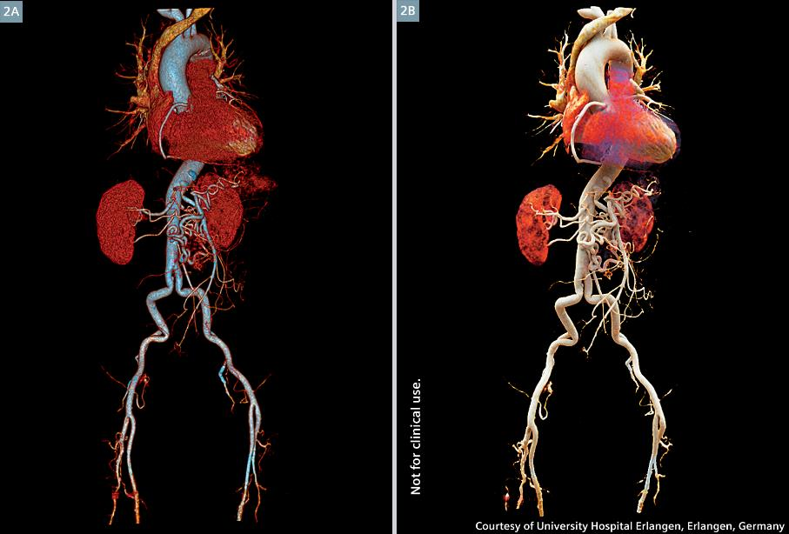
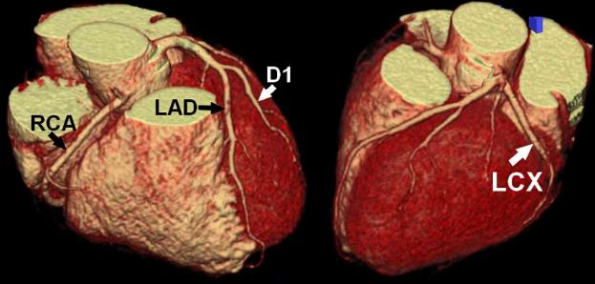
Helical/Spiral CT Angiography

Slide 39
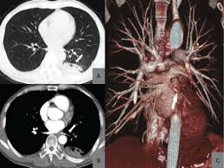
Lung CT Images & Rendering

Slide 40
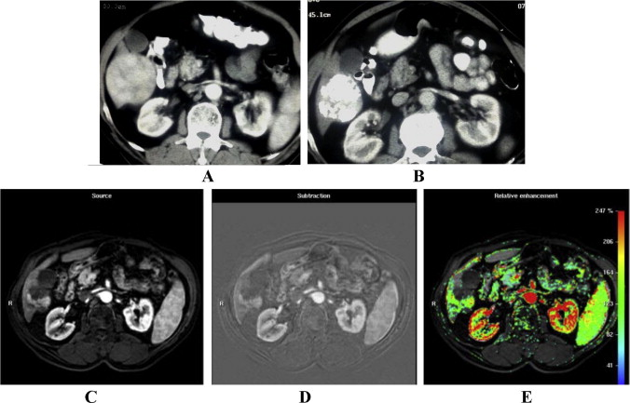
Contrast-enhanced CT

Slide 41
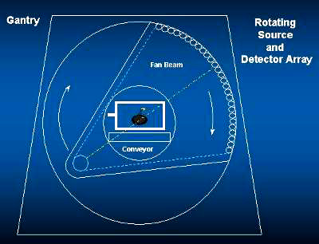
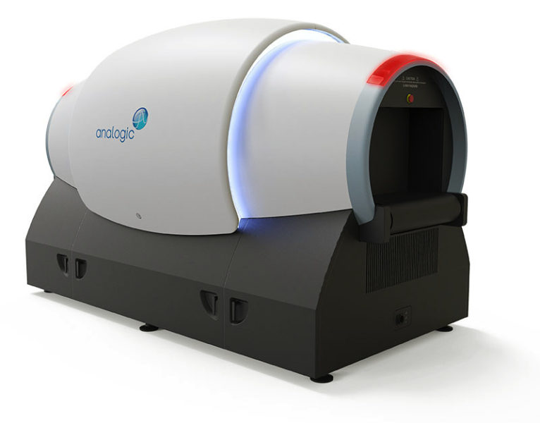
Airport CT Screening

Slide 42
Homework
Understand the derivation steps (Eqs. (1) – (10)) in the 1st cone-beam spiral CT paper: https://ieeexplore.ieee.org/stamp/stamp.jsp?tp=&arnumber=241876
Then, please explain why the algorithm is approximate? Under which condition(s) will the cone-beam reconstruction be exact?

